Slide 1

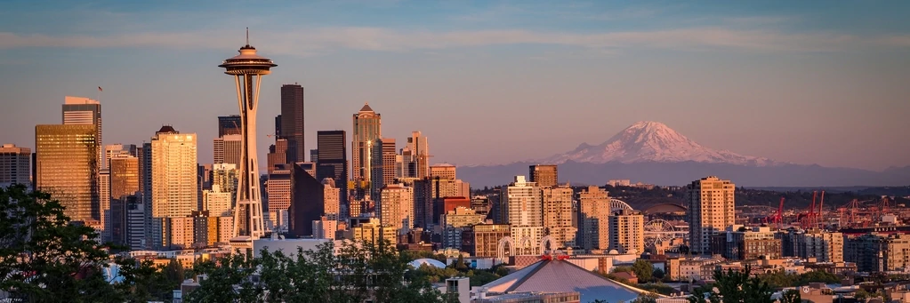
Analyzing Airbnb Seattle
Prepared by: Shantam Mogali, Jason Pastoor, Shubham Sharma, Ashish Tomar, Ruth Yang
Date: 07/30/2019

Slide 2
Agenda
Business Context Overview
Acquiring Data
High Level Overview
Data Processing
Exploratory Data Analysis
Modeling
Conclusions

Slide 3

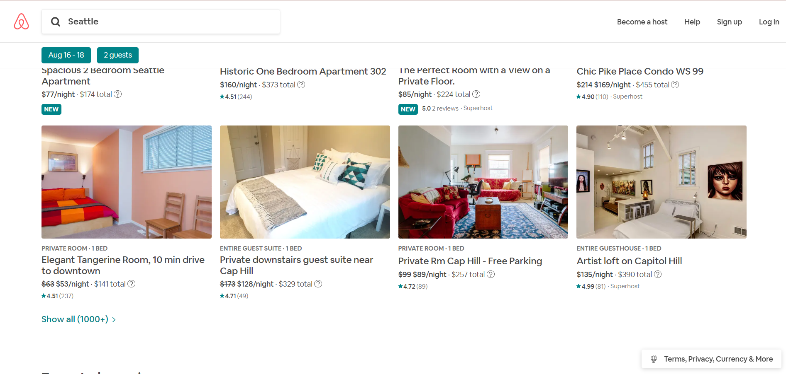
About Airbnb
Part of the ‘sharing economy’
Two-sided platform for short-term lodging
One of the fastest growing companies
A disruptive innovation
Notes:
Founded in 2008

Slide 4
About the Dataset
Retrieved from http://insideairbnb.com/
(Seattle, Washington, United States)
Listings
(8,921 X 106)
Calendar
(3,256,165 X 7)
Up-to-date as of July 14, 2019
Raw data scraped from Airbnb
Available for public use for individual cities

Slide 5
Insights on…
What are the busiest times of each season to visit Seattle?
How do prices vary across different neighborhoods?
What other factors cause variability in prices?
What is the predicted price for each listing?
Recommendations

Slide 6
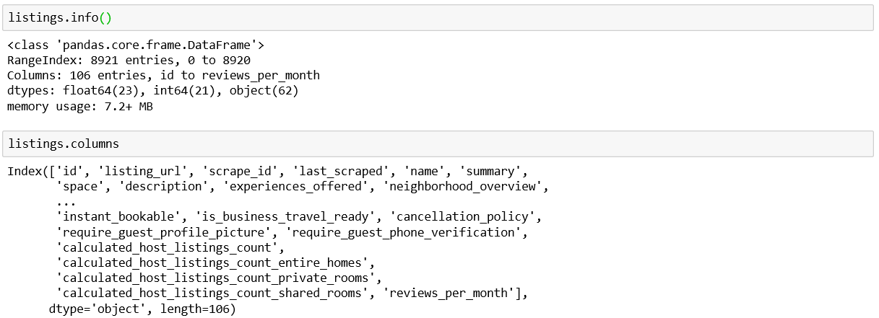
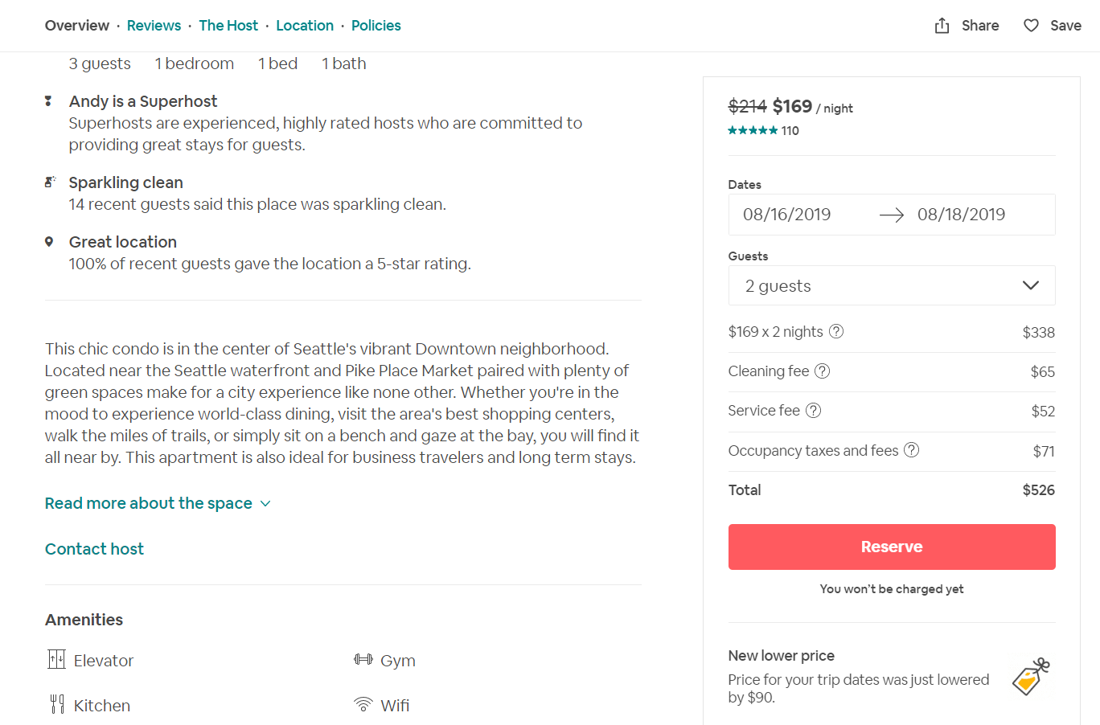
Dataset Overview
Host information
Property information
Booking information
Notes:
We did the same thing for the calendar dataset. The dataset includes available dates and price for the property for the following 365 days.

Slide 7
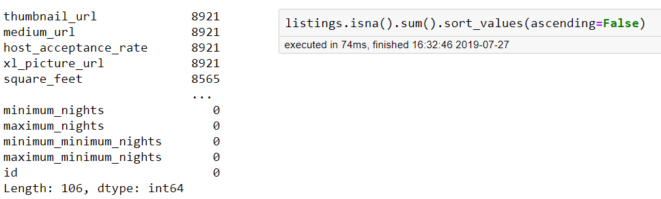
Dataset Overview (Cont.)
Checking for nulls in the overall dataset
Dropping multiple columns which have nothing but nulls
Removing columns which would not help in evaluating the result such URL links, picture sizes, descriptions, etc.

Slide 8
Data Cleaning & Preparation Overview
Cleaning price values & other columns
Handling date conversions and new columns
Managing missing data
Understanding and removing outliers
Feature engineering: Amenities, Property Type & Room Type
Feature engineering: Distance from Downtown

Slide 9
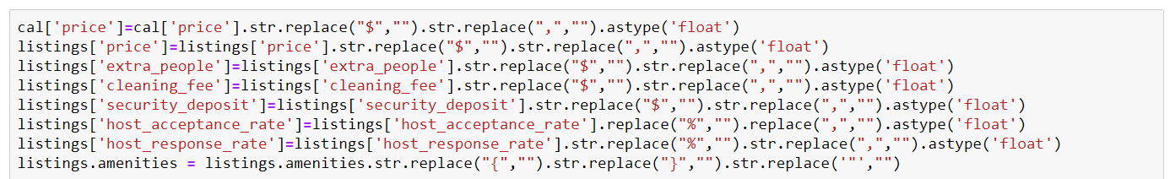
Data Cleaning
Remove $ sign from price column
Remove % sign from rate columns
Converting strings to floats
Format amenities column
Converting strings (‘t’ and ‘f’) to boolean
Notes:
In the dataset we used, we encountered multiple columns which contained prices that were qualified as string even though they were integers. To handle price columns, we first removed the dollar symbol, then remove the commas and converted them to float datatype.
In similar fashion, we did this for values which were in percentage. We first remove the percent symbol and commas and converted to float time.
Also, there were multiple t and f, which were converted to 1s and 0s

Slide 10
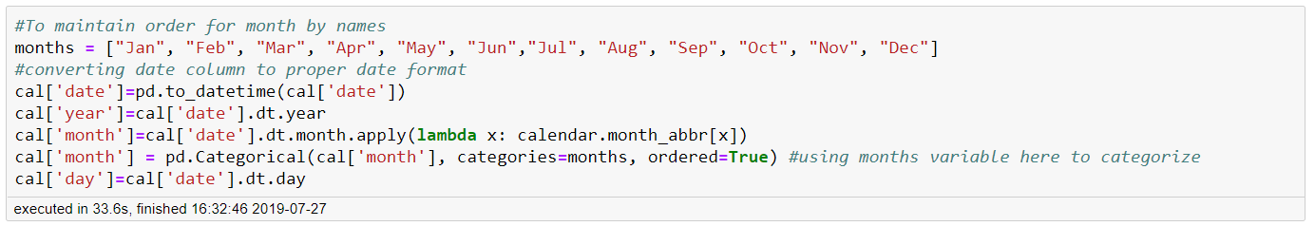
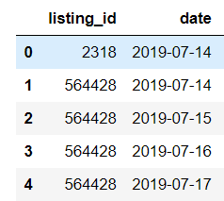
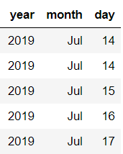
Data Cleaning (Cont.)
Formatting dates
Notes:
In the original dataset, we had just a date column which was not even defined as date data type. We first parsed the date column to datetime. Then using the datetime methods year, month and day. We created new columns which we would use later in descriptive analysis.
Since our month column is mmm format, i.e. Jan, Feb. If we sort them, pandas will sort them alphabetically. To handle this, we created a list with correct order and assigned order to month column.

Slide 11
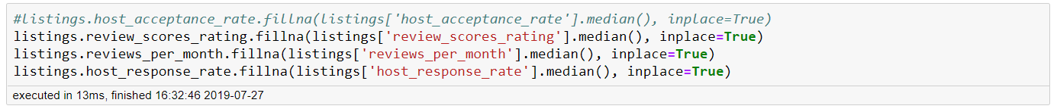
Data Cleaning (Cont.)
Null Value Imputation
Replace null values by median
Avoid impact of outliers
Notes:
We had three columns which partially contained null values. Since these three columns were important, the option to drop the columns was not considered.
We chose to fill the ratings, reviews per month and response rate with median instead of the mean because the range of these column varied by a lot. So the mean implied incorrect information.

Slide 12
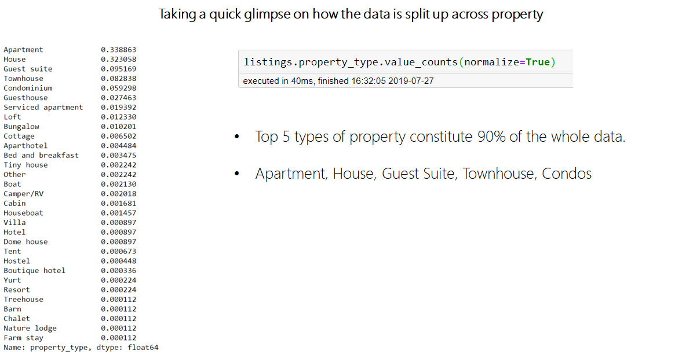
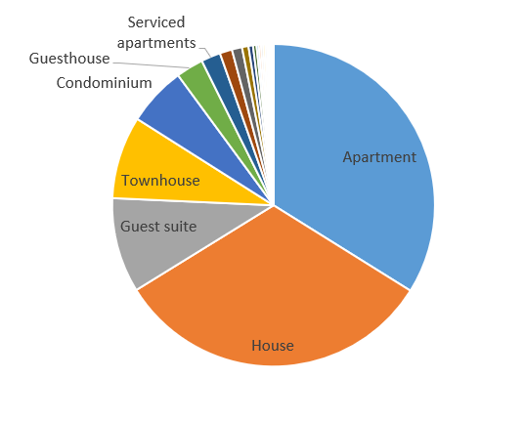
Data Cleaning (Cont.)
Taking a quick glimpse on how the data is split up across property type
Top 5 property types constitute 90% of listings

Slide 13
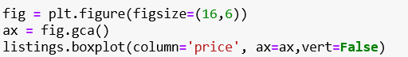
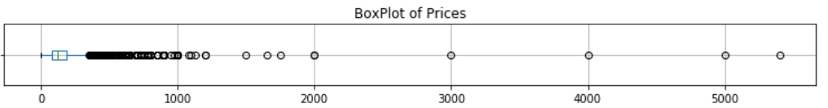
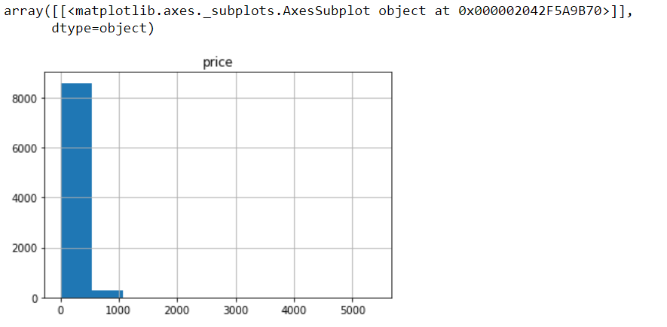
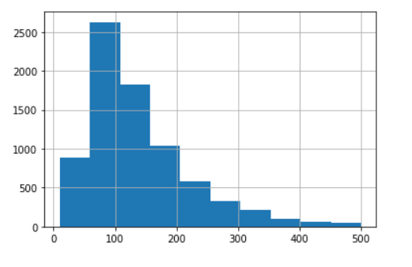
Data Cleaning (Cont.)
Removing Outliers
Notes:
Outliers are considered above price>500

Slide 14
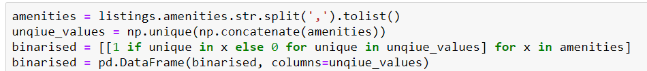
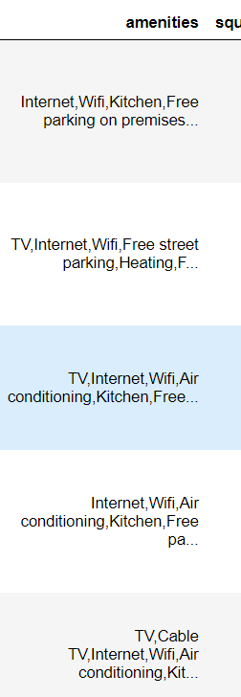
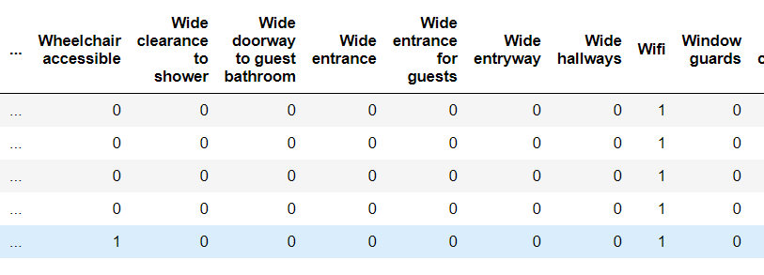
Data Preparation
Feature Engineering on Amenities
One Hot Encoding
Same for property type, bed type, neighborhood, room type

Slide 15
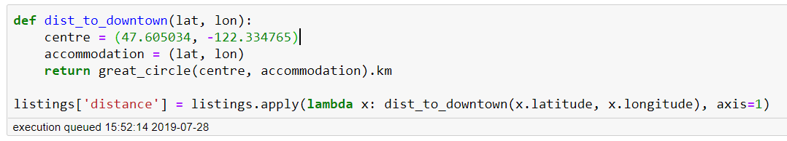
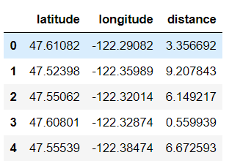
Data Preparation (Cont.)
Feature Engineering on Distance to Center of City

Slide 16
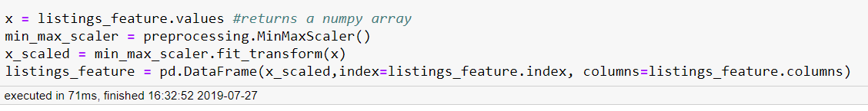
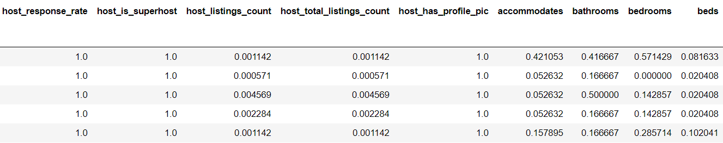
Data Preparation (Cont.)
Normalization

Slide 17
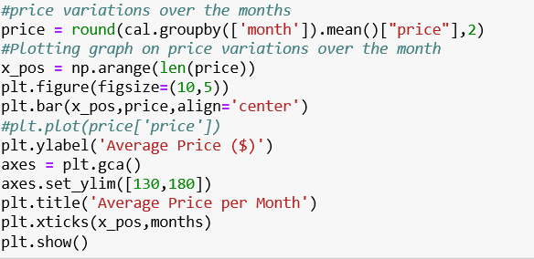
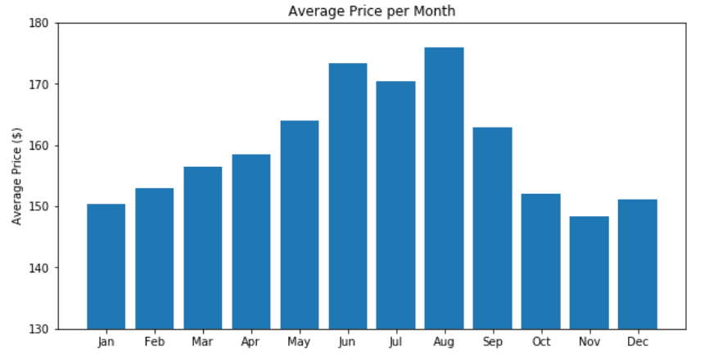
Descriptive Analysis
Price Variation by Time
Demand is highest during the summer months
People are less likely to visit Seattle during the winters

Slide 18
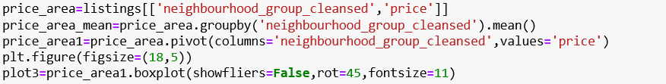
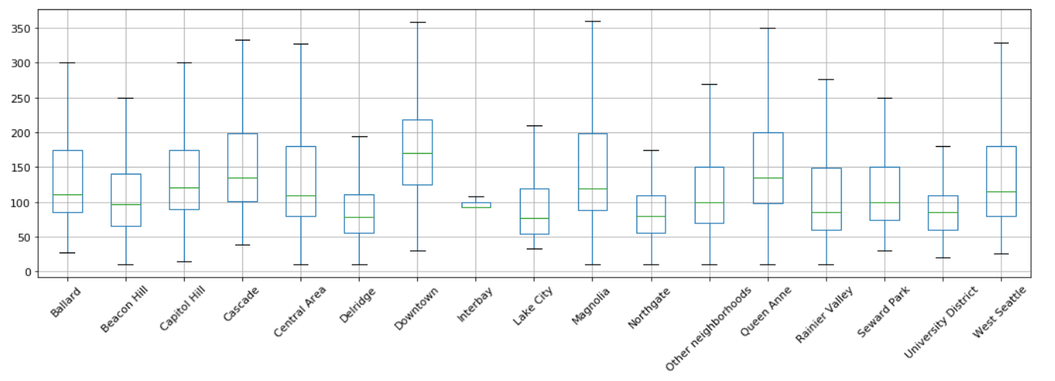
Descriptive Analysis (Cont.)
Price Variation by Neighborhood
High price variation and median in downtown
Low variation in Interbay is because of fewer data points
Overall median price is $120

Slide 19
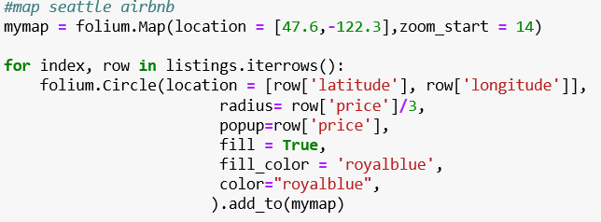
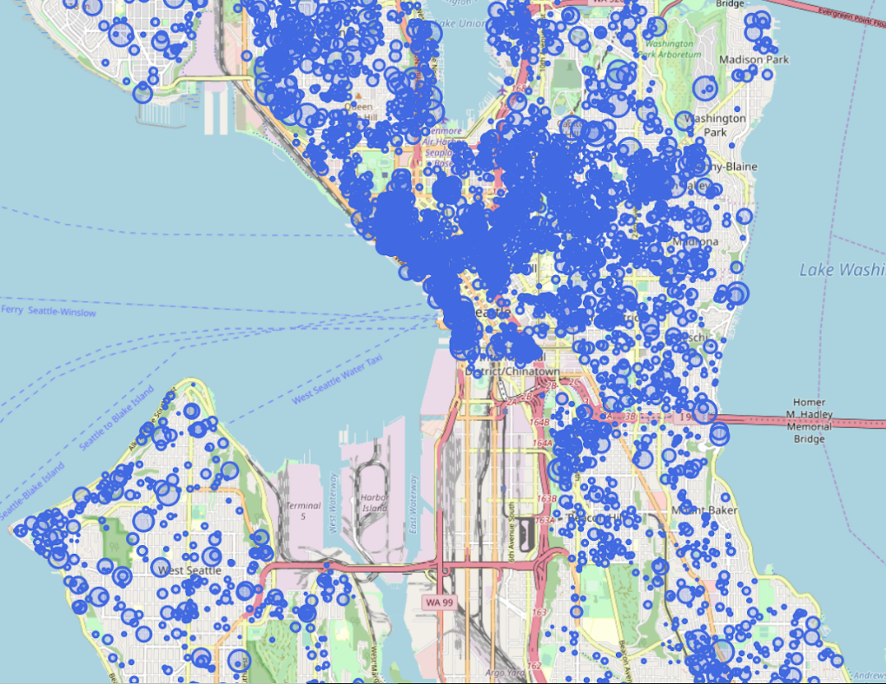
Descriptive Analysis (Cont.)
Price Variation by Area & Listing Density
Capitol Hill: Seattle’s coolest neighborhood with an abundance of brunch spots, bars and commercial thoroughfares.
Waterfront: Due to high number of summer events as well as proximity to downtown.(Seattle Great Wheel)
Georgetown: Almost negligible listings in spite of proximity to downtown area, due to it being an industrial area.

Slide 20
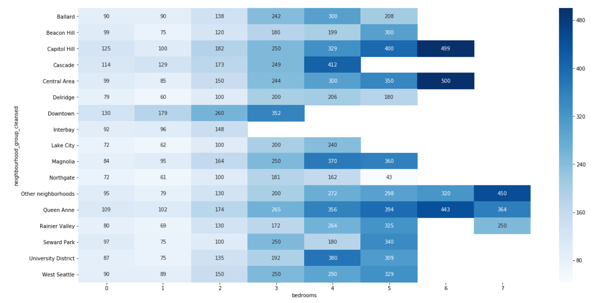
Descriptive Analysis (Cont.)
Price variation per bedroom per neighborhood
In Downtown max bedroom available is of 3 bedrooms
Downtown has high population density & small property size
Price increases as number of bedrooms increases

Slide 21
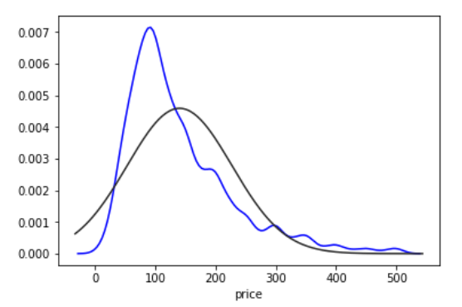
Descriptive Analysis (Cont.)
Price Skewness
Right skewed graph
Most observations occur on the low-medium end, but price can reach very high values.
Abrupt peaks at common prices such as 200,300,350, etc.

Slide 22
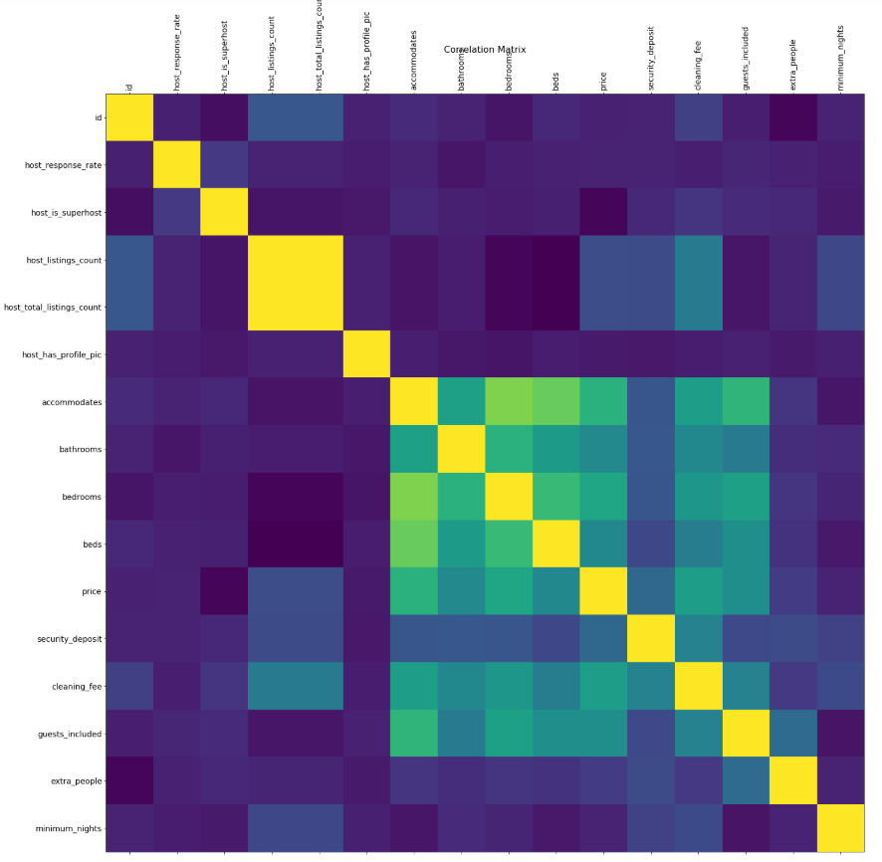
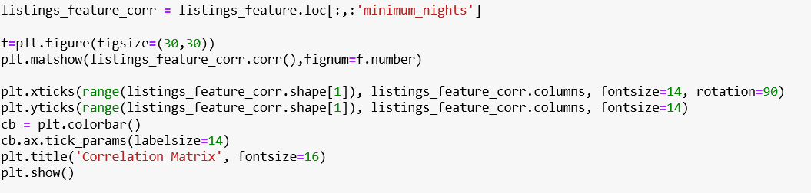
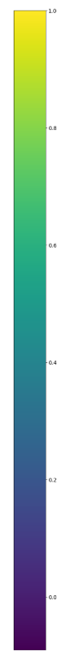
Descriptive Analysis (Cont.)
Correlation Matrix
Green-Yellow part indicates high correlation
Bedroom, accommodates, bathroom, security deposit, cleaning fee, etc. are variables that highly correlated with price

Slide 23











Predictive Analysis
Accommodates
Price
Modeling
Bathrooms
Number of Bedrooms
Security deposit
Amenities
(e.g. TV, Family/kid friendly)
Cleaning fees
Entire home/apt
Distance from downtown
Air conditioning
Private room

Slide 24
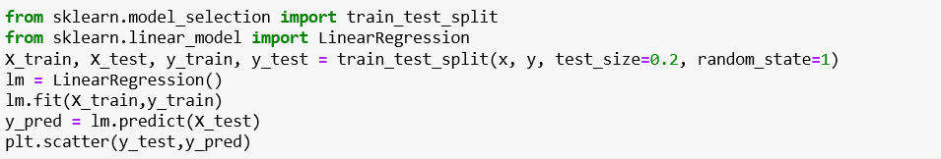
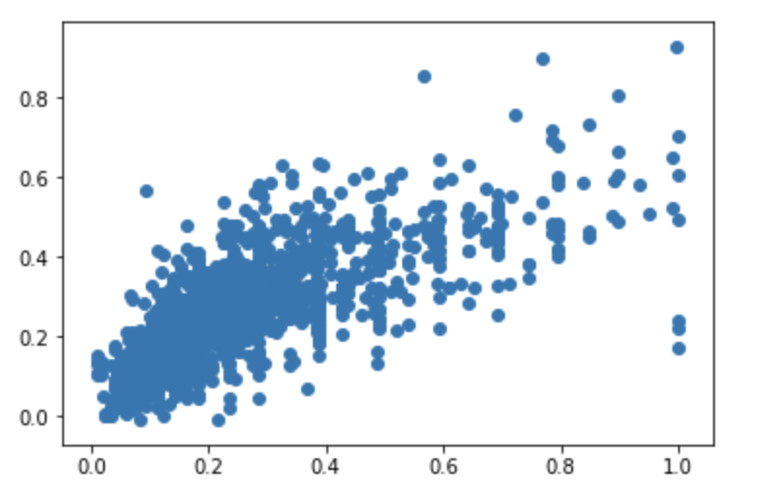
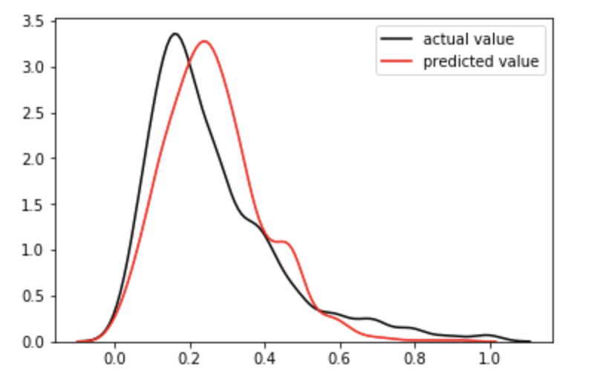
Predictive Analysis
Linear Regression
Adjusted R Square is 85.9%
Mean Absolute Error is .083

Slide 25
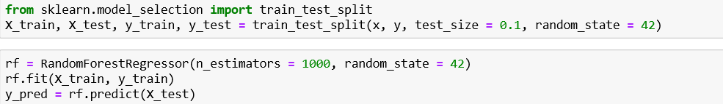
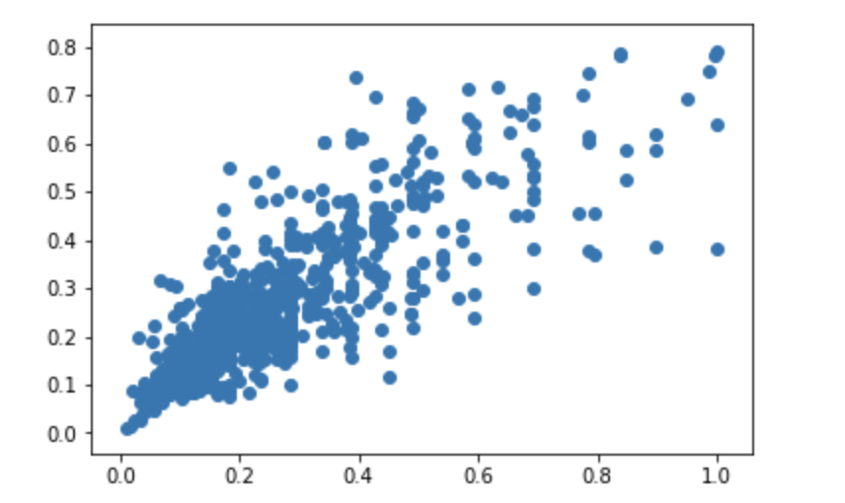
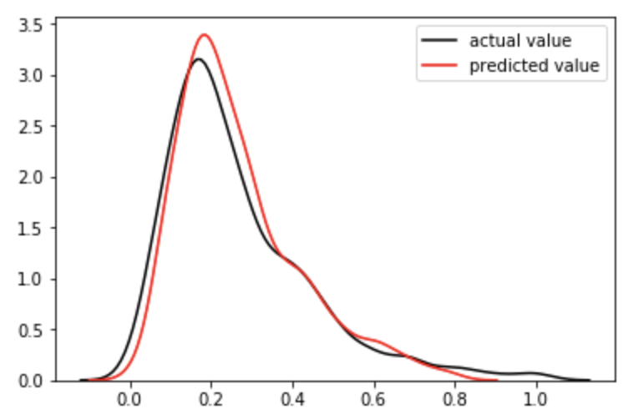
Predictive Analysis
Random Forest
Adjusted R Square is 88.2%
Mean absolute error is .067

Slide 26
Recommendations Based on Model
Price = 0.1927*accommodates + 0.4517*bedrooms + 0.2121*cleaning_fee + 0.1559*Entirehome/apt + 0.0168*Air_conditioning + 0.1476*bathrooms + 0.0238*TV + 0.1368*security_deposit + 0.0113*Family/kid_friendly +0.0862*Private_room – 0.2057*distance_from_citycenter
The model predicts the price based on the above variables.
The price recommended follows distribution of all the listings across Seattle.
The price will be in the middle of all the prices for listings with similar variables.

Slide 27
Conclusion
Adding amenities like AC, family kid friendly and TV can increase the price.
These results can be used by both sides of this marketplace: to help hosts set prices competitively, and to help guests find the best value listings.
Based on these variables, hosts can set their listing prices according to the model.
Model can also be used to advise on whether investing in a new amenity is worth it based on predicted price increase.
Listings with the greatest negative residuals are the best values based on size, location, amenities, etc.

Slide 28
Questions

Slide 29
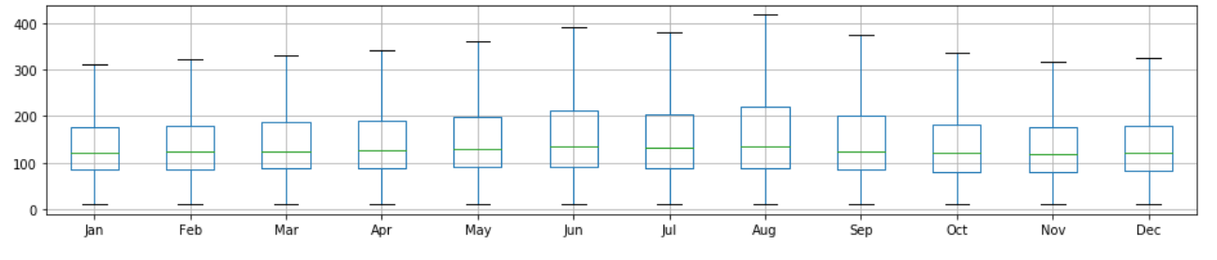
Appendix A
Price Variation by Time

Slide 30
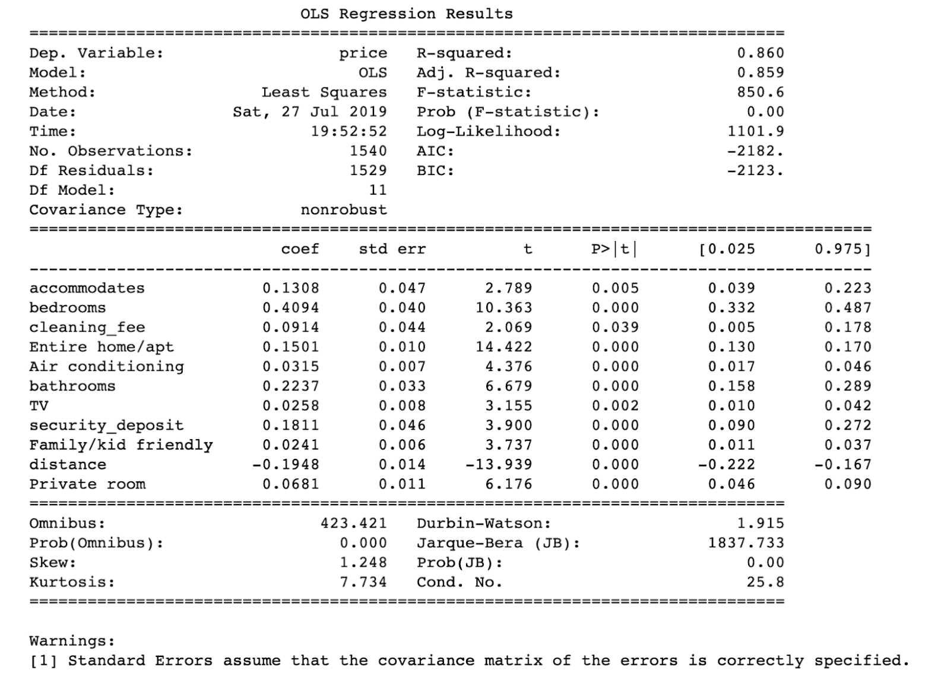
Appendix B
Linear Regression OLS

Slide 31
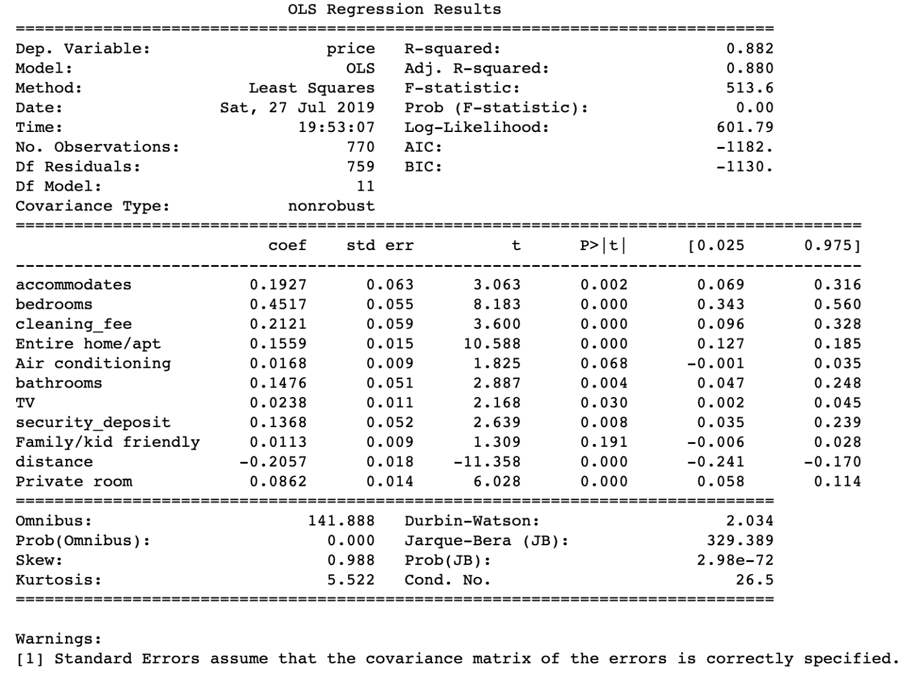
Appendix C
Random Forest OLS

